Slide 1
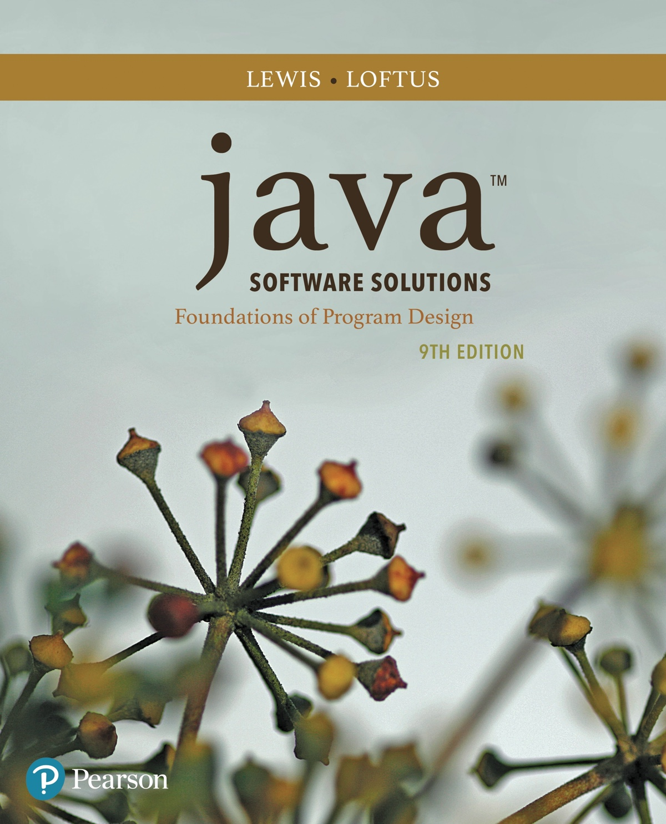
Chapter 2 Data and Expressions
Java Software Solutions
Foundations of Program Design
9th Edition
John Lewis
William Loftus

Slide 2
Data and Expressions
Let's explore some other fundamental programming concepts
Chapter 2 focuses on:
character strings
primitive data
the declaration and use of variables
expressions and operator precedence
data conversions
accepting input from the user

Slide 3
Outline
Character Strings
Variables and Assignment
Primitive Data Types
Expressions
Data Conversion
Interactive Programs

Slide 4
Character Strings
A string literal is represented by putting double quotes around the text
Examples:
"This is a string literal."
"123 Main Street"
"X"
Every character string is an object in Java, defined by the String class
Every string literal represents a String object

Slide 5
The println Method
In the Lincoln program from Chapter 1, we invoked the println method to print a character string
The System.out object represents a destination (the monitor screen) to which we can send output
System.out.println("Whatever you are, be a good one.");
object
method
name
information provided to the method
(parameters)

Slide 6
The print Method
The System.out object provides another service as well
The print method is similar to the println method, except that it does not advance to the next line
Therefore anything printed after a print statement will appear on the same line
See Countdown.java

Slide 7
//********************************************************************
// Countdown.java Author: Lewis/Loftus
//
// Demonstrates the difference between print and println.
//********************************************************************
public class Countdown
{
//-----------------------------------------------------------------
// Prints two lines of output representing a rocket countdown.
//-----------------------------------------------------------------
public static void main(String[] args)
{
System.out.print("Three... ");
System.out.print("Two... ");
System.out.print("One... ");
System.out.print("Zero... ");
System.out.println("Liftoff!"); // appears on first output line
System.out.println("Houston, we have a problem.");
}
}

Slide 8
Output
Three... Two... One... Zero... Liftoff!
Houston, we have a problem.
//********************************************************************
// Countdown.java Author: Lewis/Loftus
//
// Demonstrates the difference between print and println.
//********************************************************************
public class Countdown
{
//-----------------------------------------------------------------
// Prints two lines of output representing a rocket countdown.
//-----------------------------------------------------------------
public static void main(String[] args)
{
System.out.print("Three... ");
System.out.print("Two... ");
System.out.print("One... ");
System.out.print("Zero... ");
System.out.println("Liftoff!"); // appears on first output line
System.out.println("Houston, we have a problem.");
}
}

Slide 9
String Concatenation
The string concatenation operator (+) is used to append one string to the end of another
"Peanut butter " + "and jelly"
It can also be used to append a number to a string
A string literal cannot be broken across two lines in a program
See Facts.java

Slide 10
//********************************************************************
// Facts.java Author: Lewis/Loftus
//
// Demonstrates the use of the string concatenation operator and the
// automatic conversion of an integer to a string.
//********************************************************************
public class Facts
{
//-----------------------------------------------------------------
// Prints various facts.
//-----------------------------------------------------------------
public static void main(String[] args)
{
// Strings can be concatenated into one long string
System.out.println("We present the following facts for your "
+ "extracurricular edification:");
System.out.println();
// A string can contain numeric digits
System.out.println("Letters in the Hawaiian alphabet: 12");
continue

Slide 11
continue
// A numeric value can be concatenated to a string
System.out.println("Dialing code for Antarctica: " + 672);
System.out.println("Year in which Leonardo da Vinci invented "
+ "the parachute: " + 1515);
System.out.println("Speed of ketchup: " + 40 + " km per year");
}
}

Slide 12
Output
We present the following facts for your extracurricular edification:
Letters in the Hawaiian alphabet: 12
Dialing code for Antarctica: 672
Year in which Leonardo da Vinci invented the parachute: 1515
Speed of ketchup: 40 km per year
continue
// A numeric value can be concatenated to a string
System.out.println("Dialing code for Antarctica: " + 672);
System.out.println("Year in which Leonardo da Vinci invented "
+ "the parachute: " + 1515);
System.out.println("Speed of ketchup: " + 40 + " km per year");
}
}

Slide 13
String Concatenation
The + operator is also used for arithmetic addition
The function that it performs depends on the type of the information on which it operates
If both operands are strings, or if one is a string and one is a number, it performs string concatenation
If both operands are numeric, it adds them
The + operator is evaluated left to right, but parentheses can be used to force the order
See Addition.java

Slide 14
//********************************************************************
// Addition.java Author: Lewis/Loftus
//
// Demonstrates the difference between the addition and string
// concatenation operators.
//********************************************************************
public class Addition
{
//-----------------------------------------------------------------
// Concatenates and adds two numbers and prints the results.
//-----------------------------------------------------------------
public static void main(String[] args)
{
System.out.println("24 and 45 concatenated: " + 24 + 45);
System.out.println("24 and 45 added: " + (24 + 45));
}
}

Slide 15
Output
24 and 45 concatenated: 2445
24 and 45 added: 69
//********************************************************************
// Addition.java Author: Lewis/Loftus
//
// Demonstrates the difference between the addition and string
// concatenation operators.
//********************************************************************
public class Addition
{
//-----------------------------------------------------------------
// Concatenates and adds two numbers and prints the results.
//-----------------------------------------------------------------
public static void main(String[] args)
{
System.out.println("24 and 45 concatenated: " + 24 + 45);
System.out.println("24 and 45 added: " + (24 + 45));
}
}

Slide 16
Quick Check
What output is produced by the following?
System.out.println("X: " + 25);
System.out.println("Y: " + (15 + 50));
System.out.println("Z: " + 300 + 50);

Slide 17
Quick Check
What output is produced by the following?
System.out.println("X: " + 25);
System.out.println("Y: " + (15 + 50));
System.out.println("Z: " + 300 + 50);
X: 25
Y: 65
Z: 30050

Slide 18
Escape Sequences
What if we wanted to print the quote character?
The following line would confuse the compiler because it would interpret the second quote as the end of the string
System.out.println("I said "Hello" to you.");
An escape sequence is a series of characters that represents a special character
An escape sequence begins with a backslash character (\)
System.out.println("I said \"Hello\" to you.");

Slide 19
Escape Sequences
Some Java escape sequences:
Escape Sequence
\b
\t
\n
\r
\"
\'
\\
Meaning
backspace
tab
newline
carriage return
double quote
single quote
backslash
See Roses.java

Slide 20
//********************************************************************
// Roses.java Author: Lewis/Loftus
//
// Demonstrates the use of escape sequences.
//********************************************************************
public class Roses
{
//-----------------------------------------------------------------
// Prints a poem (of sorts) on multiple lines.
//-----------------------------------------------------------------
public static void main(String[] args)
{
System.out.println("Roses are red,\n\tViolets are blue,\n" +
"Sugar is sweet,\n\tBut I have \"commitment issues\",\n\t" +
"So I'd rather just be friends\n\tAt this point in our " +
"relationship.");
}
}

Slide 21
Output
Roses are red,
Violets are blue,
Sugar is sweet,
But I have "commitment issues",
So I'd rather just be friends
At this point in our relationship.
//********************************************************************
// Roses.java Author: Lewis/Loftus
//
// Demonstrates the use of escape sequences.
//********************************************************************
public class Roses
{
//-----------------------------------------------------------------
// Prints a poem (of sorts) on multiple lines.
//-----------------------------------------------------------------
public static void main(String[] args)
{
System.out.println("Roses are red,\n\tViolets are blue,\n" +
"Sugar is sweet,\n\tBut I have \"commitment issues\",\n\t" +
"So I'd rather just be friends\n\tAt this point in our " +
"relationship.");
}
}

Slide 22
Quick Check
Write a single println statement that produces the following output:
"Thank you all for coming to my home
tonight," he said mysteriously.

Slide 23
Quick Check
Write a single println statement that produces the following output:
"Thank you all for coming to my home
tonight," he said mysteriously.
System.out.println("\"Thank you all for " +
"coming to my home\ntonight,\" he said " +
"mysteriously.");

Slide 24
Outline
Character Strings
Variables and Assignment
Primitive Data Types
Expressions
Data Conversion
Interactive Programs

Slide 25
Variables
A variable is a name for a location in memory that holds a value
A variable declaration specifies the variable's name and the type of information that it will hold
data type
variable name
int total;
int count, temp, result;
Multiple variables can be created in one declaration

Slide 26
Variable Initialization
A variable can be given an initial value in the declaration
int sum = 0;
int base = 32, max = 149;
When a variable is referenced in a program, its current value is used
See PianoKeys.java

Slide 27
//********************************************************************
// PianoKeys.java Author: Lewis/Loftus
//
// Demonstrates the declaration, initialization, and use of an
// integer variable.
//********************************************************************
public class PianoKeys
{
//-----------------------------------------------------------------
// Prints the number of keys on a piano.
//-----------------------------------------------------------------
public static void main(String[] args)
{
int keys = 88;
System.out.println("A piano has " + keys + " keys.");
}
}

Slide 28
Output
A piano has 88 keys.
//********************************************************************
// PianoKeys.java Author: Lewis/Loftus
//
// Demonstrates the declaration, initialization, and use of an
// integer variable.
//********************************************************************
public class PianoKeys
{
//-----------------------------------------------------------------
// Prints the number of keys on a piano.
//-----------------------------------------------------------------
public static void main(String[] args)
{
int keys = 88;
System.out.println("A piano has " + keys + " keys.");
}
}

Slide 29
Assignment
An assignment statement changes the value of a variable
The assignment operator is the = sign
total = 55;
The value that was in total is overwritten
You can only assign a value to a variable that is consistent with the variable's declared type
See Geometry.java

Slide 30
//********************************************************************
// Geometry.java Author: Lewis/Loftus
//
// Demonstrates the use of an assignment statement to change the
// value stored in a variable.
//********************************************************************
public class Geometry
{
//-----------------------------------------------------------------
// Prints the number of sides of several geometric shapes.
//-----------------------------------------------------------------
public static void main(String[] args)
{
int sides = 7; // declaration with initialization
System.out.println("A heptagon has " + sides + " sides.");
sides = 10; // assignment statement
System.out.println("A decagon has " + sides + " sides.");
sides = 12;
System.out.println("A dodecagon has " + sides + " sides.");
}
}

Slide 31
Output
A heptagon has 7 sides.
A decagon has 10 sides.
a dodecagon has 12 sides.
//********************************************************************
// Geometry.java Author: Lewis/Loftus
//
// Demonstrates the use of an assignment statement to change the
// value stored in a variable.
//********************************************************************
public class Geometry
{
//-----------------------------------------------------------------
// Prints the number of sides of several geometric shapes.
//-----------------------------------------------------------------
public static void main(String[] args)
{
int sides = 7; // declaration with initialization
System.out.println("A heptagon has " + sides + " sides.");
sides = 10; // assignment statement
System.out.println("A decagon has " + sides + " sides.");
sides = 12;
System.out.println("A dodecagon has " + sides + " sides.");
}
}

Slide 32
Constants
A constant is an identifier that is similar to a variable except that it holds the same value during its entire existence
As the name implies, it is constant, not variable
The compiler will issue an error if you try to change the value of a constant
In Java, we use the final modifier to declare a constant
final int MIN_HEIGHT = 69;

Slide 33
Constants
Constants are useful for three important reasons
First, they give meaning to otherwise unclear literal values
Example: MAX_LOAD means more than the literal 250
Second, they facilitate program maintenance
If a constant is used in multiple places, its value need only be set in one place
Third, they formally establish that a value should not change, avoiding inadvertent errors by other programmers

Slide 34
Outline
Character Strings
Variables and Assignment
Primitive Data Types
Expressions
Data Conversion
Interactive Programs

Slide 35
Primitive Data
There are eight primitive data types in Java
Four of them represent integers:
byte, short, int, long
Two of them represent floating point numbers:
float, double
One of them represents characters:
char
And one of them represents boolean values:
boolean

Slide 36
Numeric Primitive Data
The difference between the numeric primitive types is their size and the values they can store:
Type
byte
short
int
long
float
double
Storage
8 bits
16 bits
32 bits
64 bits
32 bits
64 bits
Min Value
-128
-32,768
-2,147,483,648
< -9 x 10¹⁸
+/- 3.4 x 10³⁸ with 7 significant digits
+/- 1.7 x 10³⁰⁸ with 15 significant digits
Max Value
127
32,767
2,147,483,647
> 9 x 10¹⁸

Slide 37
Characters
A char variable stores a single character
Character literals are delimited by single quotes:
'a' 'X' '7' '$' ',' '\n'
Example declarations:
char topGrade = 'A';
char terminator = ';', separator = ' ';
Note the difference between a primitive character variable, which holds only one character, and a String object, which can hold multiple characters

Slide 38
Character Sets
A character set is an ordered list of characters, with each character corresponding to a unique number
A char variable in Java can store any character from the Unicode character set
The Unicode character set uses sixteen bits per character, allowing for 65,536 unique characters
It is an international character set, containing symbols and characters from many world languages

Slide 39
Characters
The ASCII character set is older and smaller than Unicode, but is still quite popular
The ASCII characters are a subset of the Unicode character set, including:
uppercase letters
lowercase letters
punctuation
digits
special symbols
control characters
A, B, C, …
a, b, c, …
period, semi-colon, …
0, 1, 2, …
&, |, \, …
carriage return, tab, ...

Slide 40
Boolean
A boolean value represents a true or false condition
The reserved words true and false are the only valid values for a boolean type
boolean done = false;
A boolean variable can also be used to represent any two states, such as a light bulb being on or off

Slide 41
Outline
Character Strings
Variables and Assignment
Primitive Data Types
Expressions
Data Conversion
Interactive Programs

Slide 42
Expressions
An expression is a combination of one or more operators and operands
Arithmetic expressions compute numeric results and make use of the arithmetic operators:
Addition
Subtraction
Multiplication
Division
Remainder
+
-
*
/
%
If either or both operands are floating point values, then the result is a floating point value

Slide 43
Division and Remainder
If both operands to the division operator (/) are integers, the result is an integer (the fractional part is discarded)
14 / 3 equals 4
8 / 12 equals 0
The remainder operator (%) returns the remainder after dividing the first operand by the second
14 % 3 equals 2
8 % 12 equals 8

Slide 44
Quick Check
What are the results of the following expressions?
12 / 2
12.0 / 2.0
10 / 4
10 / 4.0
4 / 10
4.0 / 10
12 % 3
10 % 3
3 % 10

Slide 45
Quick Check
What are the results of the following expressions?
12 / 2
12.0 / 2.0
10 / 4
10 / 4.0
4 / 10
4.0 / 10
12 % 3
10 % 3
3 % 10
= 6
= 6.0
= 2
= 2.5
= 0
= 0.4
= 0
= 1
= 0

Slide 46
Operator Precedence
Operators can be combined into larger expressions
result = total + count / max - offset;
Operators have a well-defined precedence which determines the order in which they are evaluated
Multiplication, division, and remainder are evaluated before addition, subtraction, and string concatenation
Arithmetic operators with the same precedence are evaluated from left to right, but parentheses can be used to force the evaluation order

Slide 47
Quick Check
In what order are the operators evaluated in the following expressions?
a + b + c + d + e
a + b * c - d / e
a / (b + c) - d % e
a / (b * (c + (d - e)))

Slide 48
Quick Check
In what order are the operators evaluated in the following expressions?
a + b + c + d + e
a + b * c - d / e
1
2
3
4
3
1
4
2
a / (b + c) - d % e
2
1
4
3
a / (b * (c + (d - e)))
4
3
2
1

Slide 49
Expression Trees
The evaluation of a particular expression can be shown using an expression tree
The operators lower in the tree have higher precedence for that expression
+
a + (b – c) / d
a
/
-
d
b
c

Slide 50
Assignment Revisited
The assignment operator has a lower precedence than the arithmetic operators
First the expression on the right hand
side of the = operator is evaluated
answer = sum / 4 + MAX * lowest;
4
1
3
2
Then the result is stored in the
variable on the left hand side

Slide 51
Assignment Revisited
The right and left hand sides of an assignment statement can contain the same variable
First, one is added to the
original value of count
count = count + 1;
Then the result is stored back into count
(overwriting the original value)

Slide 52
Increment and Decrement
The increment (++) and decrement (--) operators use only one operand
The statement
count++;
is functionally equivalent to
count = count + 1;

Slide 53
Increment and Decrement
The increment and decrement operators can be applied in postfix form:
count++
or prefix form:
++count
When used as part of a larger expression, the two forms can have different effects
Because of their subtleties, the increment and decrement operators should be used with care

Slide 54
Assignment Operators
Often we perform an operation on a variable, and then store the result back into that variable
Java provides assignment operators to simplify that process
For example, the statement
num += count;
is equivalent to
num = num + count;

Slide 55
Assignment Operators
There are many assignment operators in Java, including the following:
Operator
+=
-=
*=
/=
%=
Example
x += y
x -= y
x *= y
x /= y
x %= y
Equivalent To
x = x + y
x = x - y
x = x * y
x = x / y
x = x % y

Slide 56
Assignment Operators
The right hand side of an assignment operator can be a complex expression
The entire right-hand expression is evaluated first, then the result is combined with the original variable
Therefore
result /= (total-MIN) % num;
is equivalent to
result = result / ((total-MIN) % num);

Slide 57
Assignment Operators
The behavior of some assignment operators depends on the types of the operands
If the operands to the += operator are strings, the assignment operator performs string concatenation
The behavior of an assignment operator (+=) is always consistent with the behavior of the corresponding operator (+)

Slide 58
Outline
Character Strings
Variables and Assignment
Primitive Data Types
Expressions
Data Conversion
Interactive Programs

Slide 59
Data Conversion
Sometimes it is convenient to convert data from one type to another
For example, in a particular situation we may want to treat an integer as a floating point value
These conversions do not change the type of a variable or the value that's stored in it – they only convert a value as part of a computation

Slide 60
Data Conversion
Widening conversions are safest because they tend to go from a small data type to a larger one (such as a short to an int)
Narrowing conversions can lose information because they tend to go from a large data type to a smaller one (such as an int to a short)
In Java, data conversions can occur in three ways:
assignment conversion
promotion
casting

Slide 61
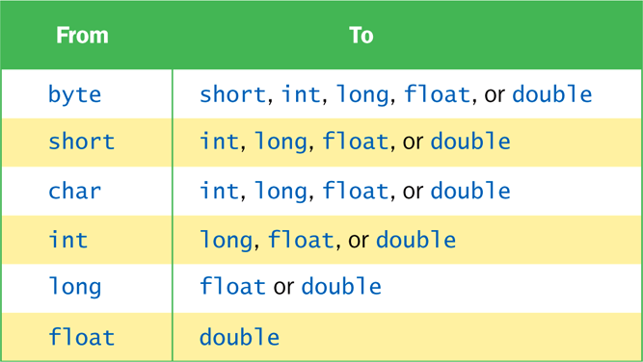
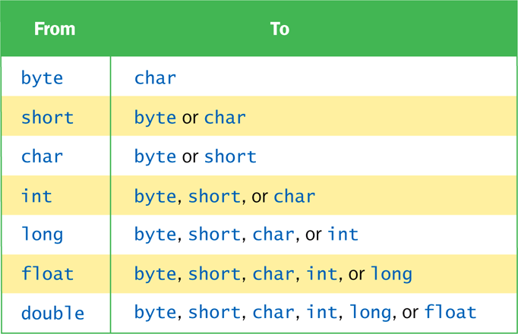
Data Conversion
Widening Conversions
Narrowing Conversions

Slide 62
Assignment Conversion
Assignment conversion occurs when a value of one type is assigned to a variable of another
Example:
int dollars = 20;
double money = dollars;
Only widening conversions can happen via assignment
Note that the value or type of dollars did not change

Slide 63
Promotion
Promotion happens automatically when operators in expressions convert their operands
Example:
int count = 12;
double sum = 490.27;
result = sum / count;
The value of count is converted to a floating point value to perform the division calculation

Slide 64
Casting
Casting is the most powerful, and dangerous, technique for conversion
Both widening and narrowing conversions can be accomplished by explicitly casting a value
To cast, the type is put in parentheses in front of the value being converted
int total = 50;
float result = (float) total / 6;
Without the cast, the fractional part of the answer would be lost

Slide 65
Outline
Character Strings
Variables and Assignment
Primitive Data Types
Expressions
Data Conversion
Interactive Programs

Slide 66
Interactive Programs
Programs generally need input on which to operate
The Scanner class provides convenient methods for reading input values of various types
A Scanner object can be set up to read input from various sources, including the user typing values on the keyboard
Keyboard input is represented by the System.in object

Slide 67
Reading Input
The following line creates a Scanner object that reads from the keyboard:
Scanner scan = new Scanner(System.in);
The new operator creates the Scanner object
Once created, the Scanner object can be used to invoke various input methods, such as:
answer = scan.nextLine();

Slide 68
Reading Input
The Scanner class is part of the java.util class library, and must be imported into a program to be used
The nextLine method reads all of the input until the end of the line is found
See Echo.java
The details of object creation and class libraries are discussed further in Chapter 3

Slide 69
//********************************************************************
// Echo.java Author: Lewis/Loftus
//
// Demonstrates the use of the nextLine method of the Scanner class
// to read a string from the user.
//********************************************************************
import java.util.Scanner;
public class Echo
{
//-----------------------------------------------------------------
// Reads a character string from the user and prints it.
//-----------------------------------------------------------------
public static void main(String[] args)
{
String message;
Scanner scan = new Scanner(System.in);
System.out.println("Enter a line of text:");
message = scan.nextLine();
System.out.println("You entered: \"" + message + "\"");
}
}

Slide 70
Sample Run
Enter a line of text:
You want fries with that?
You entered: "You want fries with that?"
//********************************************************************
// Echo.java Author: Lewis/Loftus
//
// Demonstrates the use of the nextLine method of the Scanner class
// to read a string from the user.
//********************************************************************
import java.util.Scanner;
public class Echo
{
//-----------------------------------------------------------------
// Reads a character string from the user and prints it.
//-----------------------------------------------------------------
public static void main(String[] args)
{
String message;
Scanner scan = new Scanner(System.in);
System.out.println("Enter a line of text:");
message = scan.nextLine();
System.out.println("You entered: \"" + message + "\"");
}
}

Slide 71
Input Tokens
Unless specified otherwise, white space is used to separate the elements (called tokens) of the input
White space includes space characters, tabs, new line characters
The next method of the Scanner class reads the next input token and returns it as a string
Methods such as nextInt and nextDouble read data of particular types
See GasMileage.java

Slide 72
//********************************************************************
// GasMileage.java Author: Lewis/Loftus
//
// Demonstrates the use of the Scanner class to read numeric data.
//********************************************************************
import java.util.Scanner;
public class GasMileage
{
//-----------------------------------------------------------------
// Calculates fuel efficiency based on values entered by the
// user.
//-----------------------------------------------------------------
public static void main(String[] args)
{
int miles;
double gallons, mpg;
Scanner scan = new Scanner(System.in);
continue

Slide 73
continue
System.out.print("Enter the number of miles: ");
miles = scan.nextInt();
System.out.print("Enter the gallons of fuel used: ");
gallons = scan.nextDouble();
mpg = miles / gallons;
System.out.println("Miles Per Gallon: " + mpg);
}
}

Slide 74
Sample Run
Enter the number of miles: 328
Enter the gallons of fuel used: 11.2
Miles Per Gallon: 29.28571428571429
continue
System.out.print("Enter the number of miles: ");
miles = scan.nextInt();
System.out.print("Enter the gallons of fuel used: ");
gallons = scan.nextDouble();
mpg = miles / gallons;
System.out.println("Miles Per Gallon: " + mpg);
}
}

Slide 75
Summary
Chapter 2 focused on:
character strings
primitive data
the declaration and use of variables
expressions and operator precedence
data conversions
accepting input from the user

